Slide 1
EC 499 Final Project
Konstantinos Sarinopoulos
Michigan State University
12/5/2022

Slide 2
Research Question
Question: How Covid-19 lockdowns changed electricity consumption behavior?
Contribution: Add more time to retroactive study, specifically look at stringency levels
Key Data Sources: St. Louis FRED, US Energy Information Administration, National Center for Environmental Information, University of Oxford

Slide 3
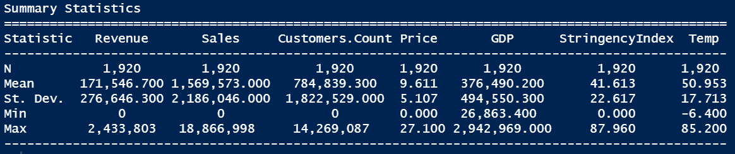
Summary Statistics
Revenue – Thousands of Dollars
Sales – MWh
Price - ¢/kWh

Slide 4
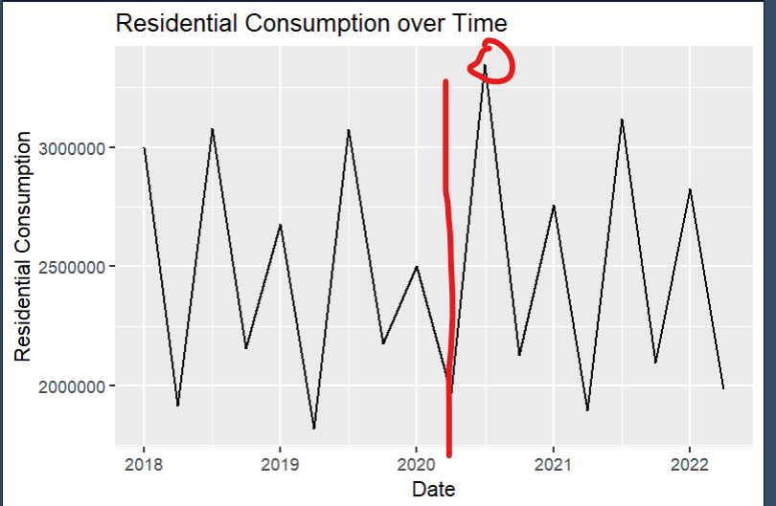
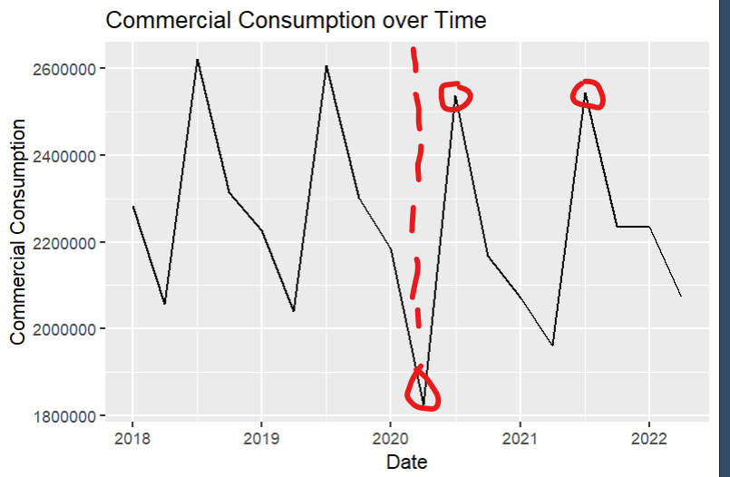
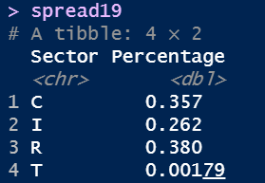
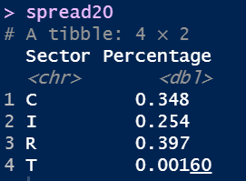
Summary Statistics – Consumption Differences
Residential increased by 2%
9,314,598 MWh increase
Power for around 9,000,000 homes

Slide 5
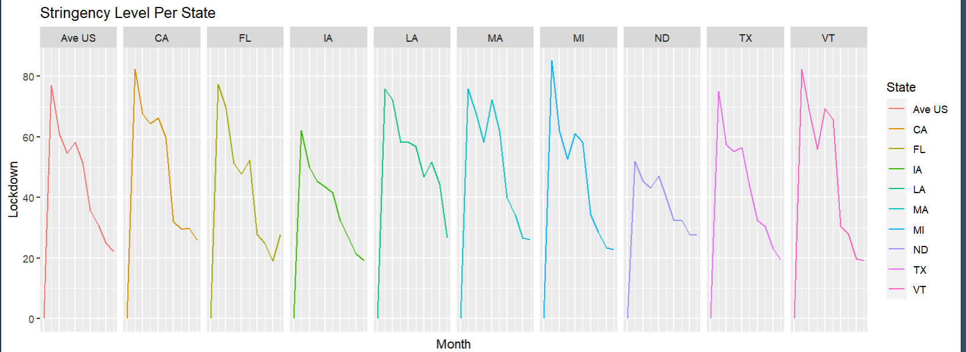
Summary Statistics – Stringency Index

Slide 6
Empirical Specification
Y_{s,q,r} = β₀ + β₁|T_{s,q,r} -65|+ β₂(GDP_{s,q,r}) + β₃(Stringency_{s,q,r}) + λ_{s} + θ_{q} + ε
S = state, Q = quarterly, R = Sector, λ = State Fixed Effects, θ = Time-Based Fixed Effects

Slide 7
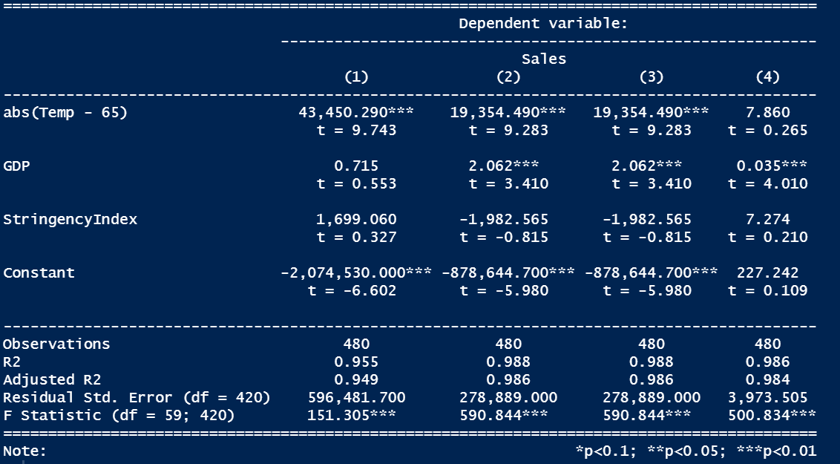
Results
Residential, Commercial, Industrial, Transportation Respectively

Slide 8
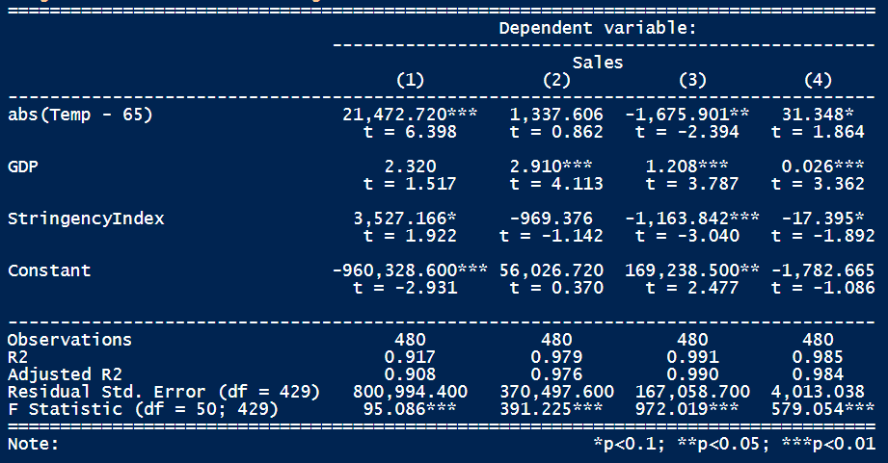
Results – Without Time Based Fixed Effects
Residential, Commercial, Industrial, Transportation Respectively

Slide 9
Conclusion
Conclusion
No significance in stringency in initial model
Positive relationship between stringency and residential consumption
Negative relationship between stringency and commercial/industrial consumption
Weakness:
Stringency Index is not a perfect measure of lockdowns
Had to use quarterly data, missing some data points
Policy Implications:
Energy Projections during lockdowns
Energy Infrastructure Planning Implications

Slide 10
Bibliography
Cicala, Steve. “Jue: Insights: Powering Work from Home.” Journal of Urban Economics, 2022, p. 103474., https://doi.org/10.1016/j.jue.2022.103474.
Brewer, Dylan. “Changes in Electricity Use Following COVID-19 Stay-at-Home Behavior.” National Bureau of Economic Research.
Buechler, Elizabeth. “Power and the Pandemic: Exploring Global Changes in Electricity Demand During COVID-19.” Precourt Institute for Energy of Stanford University.

